Slide 1
Cronjobs in Linux

Slide 2
If you're working in IT, you might need to schedule various repetitive tasks as part of your automation processes.
For example, you could schedule a particular job to periodically execute at specific times of the day. This is helpful for performing daily backups, monthly log archiving, weekly file deletion to create space, and so on.
And if you use Linux as your OS, you'll use something called a cron job to make this happen.

Slide 3
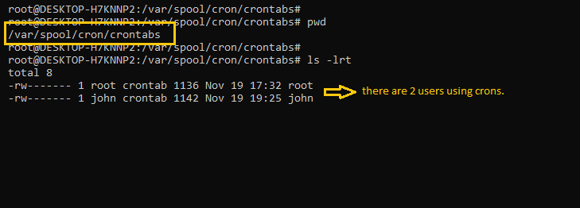
What is a cron?
Cron is a job scheduling utility present in Unix like systems. The crond daemon enables cron functionality and runs in background. The cron reads the crontab (cron tables) for running predefined scripts.
By using a specific syntax, you can configure a cron job to schedule scripts or other commands to run automatically.

Slide 4
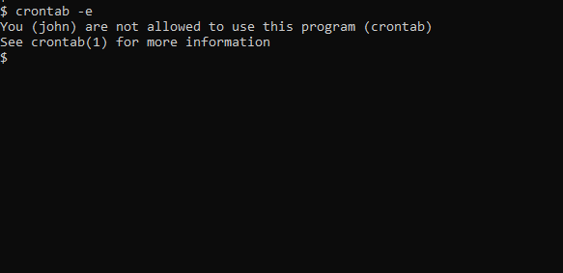
What are cron jobs in Linux?
Any task that you schedule through crons is called a cron job. Cron jobs help us automate our routine tasks, whether they're hourly, daily, monthly, or yearly.
How to Control Access to crons
In order to use cron jobs, an admin needs to allow cron jobs to be added for users in the '/etc/cron.allow' file.
If you get a prompt like this, it means you don't have permission to use cron.

Slide 5

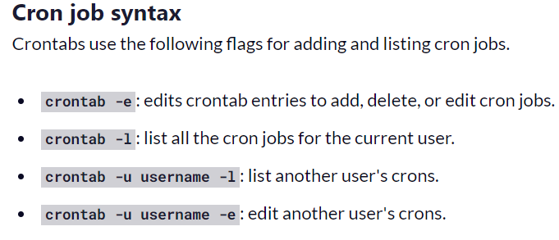
How to Add cron Jobs in Linux
First, to use cron jobs, you'll need to check the status of the cron service. If cron is not installed, you can easily download it through the package manager. Just use this to check:

Slide 6
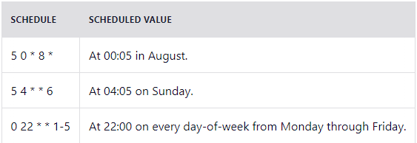
Cron job examples
Below are some examples of scheduling cron jobs.

Slide 7
Reference:
https://www.freecodecamp.org/news/cron-jobs-in-linux/

